Slide 1
Preventing Type 2 Diabetes in the Workforce:
Employer Name
Presented by Your Organization Name
January 2021
Notes:
Customization Note: Replace “Employer Name” with the employer you will be meeting with. Add your organization’s name and presentation date. Remove highlights.

Slide 2
NACDD Publication Disclaimer
Notes:
Customization Note: This slide can be deleted for presentations. It is important publication disclaimer information for the user, but does not need to be included when presenting to your audiences. If applicable, you may want to consider replacing this slide with your own organization’s disclaimer.

Slide 3
Today’s Discussion
Partner introductions (10 min)
Understanding prediabetes and the National DPP lifestyle change program (30 min)
Action planning (20 min)
Notes:
Customization Note: Update this slide to reflect your final presentation and length of meeting. Use this slide for more formal presentations. If this is your first meeting with an employer, be sure to spend more time on introductions and understanding priorities.

Slide 4
About Your Organization
Notes:
Customization Note: Fill the text box with information about your organization including: Highlight relevant work of public health (broaden employer view of what public health may do); Successes and impact on diabetes; Background working with employers, insurers, etc.; Your organization’s availability as an asset and resource. Feel free to add more slides for this topic, as appropriate.

Slide 5
Support and Technical Assistance
Notes:
Customization Note: Fill the text box with what role you expect to play with employer, such as: Regular check ins; Connecting to other employers; Support with leadership buy in; Assist with partners / vendors

Slide 6
Diabetes Landscape

Slide 7
Diabetes in the United States
Notes:
Speaker Notes: Diabetes is a chronic health condition that affects how the body turns food into energy. You’ve probably heard these statistics before and understand how prevalent diabetes is in the US and within your own workforce. What we don’t always talk as much about is that 1 in 4 who have diabetes don’t know it.
Discussion Question: When you think about 1 in 10 people on average having diabetes, do you think this is reflective of what you know about your population’s health?

Slide 8
Diabetes in State
Notes:
Customization Notes: Consider adding state-specific data about diabetes prevalence, cost, and impact. Highlight any large successes or specific impact to employer(s).

Slide 9
Diabetes in County / City
Notes:
Customization Notes: Consider adding County, City, or other local data about diabetes prevalence, cost, and impact in markets where the employer has locations. Note anything special related to diabetes impact based on what’s known about employee characteristics.

Slide 10
Preventing Diabetes Makes Sense
Health care costs for Americans with diabetes are 2.3x GREATER than those without diabetes
Diagnosed diabetes costs America
$327
Annual cost of health care for people with diabetes
$16,752
BILLION
per year
Annual cost of health care for people without diabetes
$7,151
Notes:
Speaker Notes: The American Diabetes Association estimates that in 2017, diagnosed diabetes cost the U.S. $327 billion per year. $237 billion of that is attributed for direct medical costs, while $90 billion is attributed to indirect costs like increased absence from work, reduced productivity while at work, and inability to work due to diabetes-related disability.
People with diabetes spend about 2.3 times more for medical expenses than people without diabetes.
Discussion Question: Have you seen this level of cost increase for medical expenses in employees diagnosed with diabetes? / Do you have the data you need to know this?
Considering the high cost alone of diabetes, it’s understandable why there’s such a strong effort for helping people prevent the onset of diabetes.
Sources: https://care.diabetesjournals.org/content/early/2018/03/20/dci18-0007

Slide 11
Trends in Diabetes Costs
Diabetes costs increased by 26% from 2012 – 2017
What will increases from 2017– 2022 look like if we don’t take action now?
How many more employees will have diabetes?
Notes:
Speaker Notes: In 2012, diabetes costs in the U.S. were estimated at $245 billion. That’s a 26% increase in 5 years, and is simply not sustainable. In light of this increase, two thoughts for consideration are: where will we be in 2022 if we haven’t taken any action? How many more employees will have diabetes?
Tip: Don’t rush over the 26% increase over a 5 year period. Take a moment for the employer to reflect on this.
Sources: https://care.diabetesjournals.org/content/early/2018/03/20/dci18-0007

Slide 12
More Than Diabetes
Notes:
Speaker Notes: If we take a moment to think beyond the direct impact of diabetes, we’ll see that that there are many risks associated with diabetes that could each be their own additional hurdle of prevention and management. People with diabetes are at higher risk of developing neurological, peripheral vascular, cardiovascular, renal, metabolic, and ophthalmic health conditions. General medicine also becomes an issue for people with diabetes.
From an employer perspective, think about the complexities of managing all that is associated with an employee who has multiple co-morbidities. This may appear in productivity data, medical claims costs, and even disability claims. You may already have experience in this situation.

Slide 13
Discussion: Diabetes in Your Workforce
What do you know about diabetes in your workforce?
Have you implemented any programs or benefit changes to address diabetes?
How familiar are you with prediabetes?
Notes:
Speaker Notes: That leads us to our next discussion. What do you know about diabetes among your workforce?
[leave time for an open discussion about the employer’s specific scenario]

Slide 14

34 million with diabetes
88 million with prediabetes
According to CDC’s Division of Diabetes Translation, National Diabetes Statistics Report, 2020
Notes:
Speaker Notes: You likely have a pretty good understanding of how prevalent diabetes is within your workforce, and understand what a driver of cost this can be. What you may not be aware of is how large the population with prediabetes is.
In early 2020, CDC released new data that shows 34 million Americans have diabetes, and 88 million Americans have prediabetes. CDC is working to reverse the diabetes epidemic by helping to identify people with prediabetes, prevent type 2 diabetes and diabetes complications, and improve the health of all people with diabetes. As part of their efforts, the National Diabetes Prevention Program (National DPP) provides the framework for type 2 diabetes prevention efforts in the United States. Through the National DPP’s evidence-based, affordable lifestyle change program, adults with prediabetes learn to make healthy changes that can cut their risk of type 2 diabetes by as much as 58% (71% for those over 60 years). More than 1,500 CDC-recognized organizations offer the National DPP lifestyle change program, and more than 400,000 eligible people have participated. Approximately 40 commercial health plans provide some coverage for the program, and Medicare began reimbursing for CDC-recognized in-person programs in 2018.

Slide 15
Prediabetes
More than 80%
Don’t know they
have it!
Notes:
Speaker Notes: Prediabetes is a serious health condition where blood sugar levels are higher than normal, but not high enough yet to be diagnosed as type 2 diabetes. Approximately 84 million American adults—more than 1 out of 3—have prediabetes. Of those with prediabetes, more than 80% don’t know they have it.
Source: https://www.cdc.gov/diabetes/basics/prediabetes.html

Slide 16
Risk Test
Ad Council Video:
Take the prediabetes risk test
Notes:
Customization Note: Update the Ad Council video link with whichever video you think will most appeal to your audience. Be sure you will have internet access when presenting, or remove this slide. Find all video options here: https://www.youtube.com/channel/UCFG5XgDdJHkz2aW7UJ2jn7A
Speaker Notes: There is no cure for diabetes once someone has already experienced the onset. The good news is we know that evidence-based interventions can prevent or delay the onset of diabetes. If a person has prediabetes, the CDC-led National Diabetes Prevention Program can help them make lifestyle changes to prevent or delay type 2 diabetes and other serious health problems. We’ve seen employers shift to finding ways to incorporate this short risk test into their existing health risk assessment and screening activities.
Discussion Question: Would you like to learn more (in follow up) about how we can help you plan for screening your employees for prediabetes? What partners do you currently work with to help with employee screening, health fairs, etc.?
Sources: https://www.cdc.gov/diabetes/basics/prediabetes.html; https://doihaveprediabetes.org/

Slide 17
Where Do I Start?
Gather data and use ROI calculators to better understand the burden of prediabetes on your workforce.
Gain additional knowledge about the program by:
  Talk to your peers
  Visit https://www.coveragetoolkit.org/ and https://nationaldppcsc.cdc.gov/s/
Notes:
Speaker Notes: If you’re interested in learning more about what you, as an employer, can do for your employees, we can help walk you through next steps. A good place to start would be to look at the workforce data you already have on hand to better understand the burden of prediabetes on your workforce. It’s also a good idea to run a few return on investment scenarios to determine if adding the National DPP lifestyle change program to your covered benefits would be beneficial for your organization.
Talking to other organizations who have experience with the National DPP can be a great way to get your questions answered and share strategies. Do you know of other organizations who have implemented or considered implementing this benefit? The ELC Employer Network is a great way to connect with peers. Our team can connect you with the Employer Network if/when you’re ready.
The Coverage Toolkit and the National DPP Customer Service Center both have lots of tools and information to help guide employers through the decision-making process. Consider looking at these tools ahead of your next review of benefits. We’d be happy to walk through some of them today, or set up another time to discuss them.
Sources: https://coveragetoolkit.org/commercial-plans/commercial-plans-employers/

Slide 18
The National Diabetes Prevention Program

Slide 19
The National Diabetes Prevention Program
The National Diabetes Prevention Program was established in 2010 to prevent type 2 diabetes using evidence based, low cost interventions
Notes:
Speaker Notes: Congress authorized CDC to establish the National Diabetes Prevention Program in 2010 to prevent type 2 diabetes using evidence based, low cost interventions across the US
The Diabetes Prevention Program (DPP) was a major multicenter clinical research study. The intervention involved a lifestyle change program focusing on calorie reduction and increasing physical activity to at least 150 minutes per week. Results from the study showed that this structured lifestyle change program, in which participants achieved weight loss of 5 to 7 percent of their body weight (10 to 14 pounds for a person weighing 200 pounds), reduced the risk of developing type 2 diabetes by 58 percent in adults at high risk for the disease.
Sources: https://www.niddk.nih.gov/about-niddk/research-areas/diabetes/diabetes-prevention-program-dpp

Slide 20
Public-Private Partnership
Notes:
Speaker Notes: The National Diabetes Prevention Program (National DPP) is a partnership of public and private organizations working to prevent or delay type 2 diabetes. Partners, like your organization, make it easier for people at risk for type 2 diabetes to participate in evidence-based lifestyle change programs to reduce their risk of type 2 diabetes.
Sources: https://www.cdc.gov/diabetes/prevention/index.html

Slide 21
The National DPP Lifestyle Change Program
CDC-approved curriculum
Diabetes Prevention Recognition Program (DPRP)
  CDC-recognized organizations
  Trained lifestyle coaches
Group and coach support for a full year
Notes:
Speaker Notes: CDC-recognized lifestyle change programs are a key component of the National DPP and have proven to be more effective than certain medications at preventing type 2 diabetes. They use a CDC-approved, evidence-based curriculum to help participants build new habits while lowering their risk of type 2 diabetes and improving their health. Lifestyle change programs are led by trained lifestyle coaches. Participants attend group classes and receive coaching for one year. As you identify a program provider, it’s important that you select someone who has been recognized by the CDC to make sure they are meeting the highest standards.
Sources: https://www.cdc.gov/diabetes/prevention/lcp-details.html; https://www.cdc.gov/diabetes/prevention/program-providers.htm

Slide 22
Testimonial can go here and be a few lines long.
—First Last name
Notes:
Customization Notes: Insert a quote or testimonial from a participant. This could be a quote from a business on how the program helped them and their employees, or a quote from an employee on how grateful they are that their company cares about their health. For example: “We were frankly surprised and delighted by the return on investment of adding this as a covered benefit. After years of increasing healthcare costs, we’ve seen a leveling off. And we’ve seen a reduction in absenteeism due to illness” – President, Business, Inc. OR “This program was a real blessing for me. I feel better than I’ve felt in years, and I feel more productive at work and better able to enjoy my free time.” – Joe Q. Employee
Tip: If you do not have strong testimonials, consider speaking with your CDC recognized organizations to see if they have testimonials they would be willing to share. AdCouncil video clips can also be useful here, but make sure technology is smooth prior to employer meeting.

Slide 23

Program Provider Delivery Options
In Person
Online
Distance Learning
Combination
Notes:
Speaker Notes: The National DPP lifestyle change program has four options for delivery: in person, online, distance (eg, telehealth), or a combination of any of those. There are a lot of things to consider when deciding where to offer the program. The program could be held at the worksite, in the community, virtually, or some combination of any of those. Our team can help you work through deciding which delivery option would be best for you, when the times comes.
Discussion questions: When deciding which program to offer your employees, a couple considerations include:
Do most employees have access to and feel comfortable with using apps and online solutions?
Have you offered programs like this in the past? If so, how well did it work for your employees?
If virtual, are you seeking an online classroom, app based, AI integrated, some combination? (Every program looks different!)

Slide 24
Curriculum Topics
Get active
Track activity
Eat well
Burn more calories
Shop and cook
Cope with triggers
Heart Health
Get support
When weight loss stalls
And more!
Notes:
Customization Note: Consider editing this slide to include only a few of these options, or prioritizing this list to topics that the employer would be most interested in.
Speaker Notes: The program includes a wide variety of curricula topics that are based on the original 2002 DPP trial and follow-up studies we discussed earlier. These are just a few of the 26 total topics included in the curriculum. All CDC-recognized programs will cover at least 22 of the 26 available topics in a 12-month span. Remember, this is about lifestyle change which requires a wide variety of topics and support.
Sources: https://www.cdc.gov/diabetes/prevention/resources/curriculum.html

Slide 25
Participant Goals
By the end of the first six months:
  Lose 5-7% of starting weight
  150 min of physical activity per week
By the end of the second six months:
  Keep weight off
  Keep working toward goal weight
  Lose more weight if desired
  150 min of activity per week
Notes:
Speaker Notes: The lifestyle change program helps participants achieve moderate weight loss by eating well and being active. By the end of the first six months, the goals is for participants to:
Lose at least 5 to 7 percent of their starting weight
Get at least 150 minutes of physical activity each week
By the end of the second six months, the goal is for participants to:
Keep off the weight they have lost
Keep working toward their goal weight, if not reached
Lose more weight if they wish
Keep getting at least 150 minutes of activity each week
Many program providers structure their payment model to align with these and other participant milestones, offering a pay for performance / pay for outcome model.

Slide 26
Program Eligibility
18+ years old
Overweight
No previous diagnosis of type 1 or type 2 diabetes
Plus one or more of the following
  Blood test result in the prediabetes range within the past year
  Previously diagnosed with gestational diabetes
  Score 5 or higher on the CDC / ADA Prediabetes Risk Test: https://www.cdc.gov/prediabetes/takethetest/
Notes:
Speaker Notes: Blood-based testing is the most accurate way to determine if a person has prediabetes. Prediabetes can be diagnosed via oral glucose tolerance tests, fasting blood glucose tests, or an A1C test. In instances where this isn’t available, eligibility can be determined using a short risk test.
In order to be eligible to participate in a National DPP lifestyle change program, participants must:
Be at least 18 years old, and
Be overweight (body mass index ≥25; ≥23 if Asian), and
Have no previous diagnosis of type 1 or type 2 diabetes, and
Have a blood test result in the prediabetes range within the past year:
Hemoglobin A1C: 5.7%–6.4%, or
Fasting plasma glucose: 100–125 mg/dL, or
Two-hour plasma glucose (after a 75 gm glucose load): 140–199 mg/dL, or
Be previously diagnosed with gestational diabetes, or
Score 5 or higher on the CDC / ADA Prediabetes Risk Test: https://www.cdc.gov/prediabetes/takethetest/

Slide 27
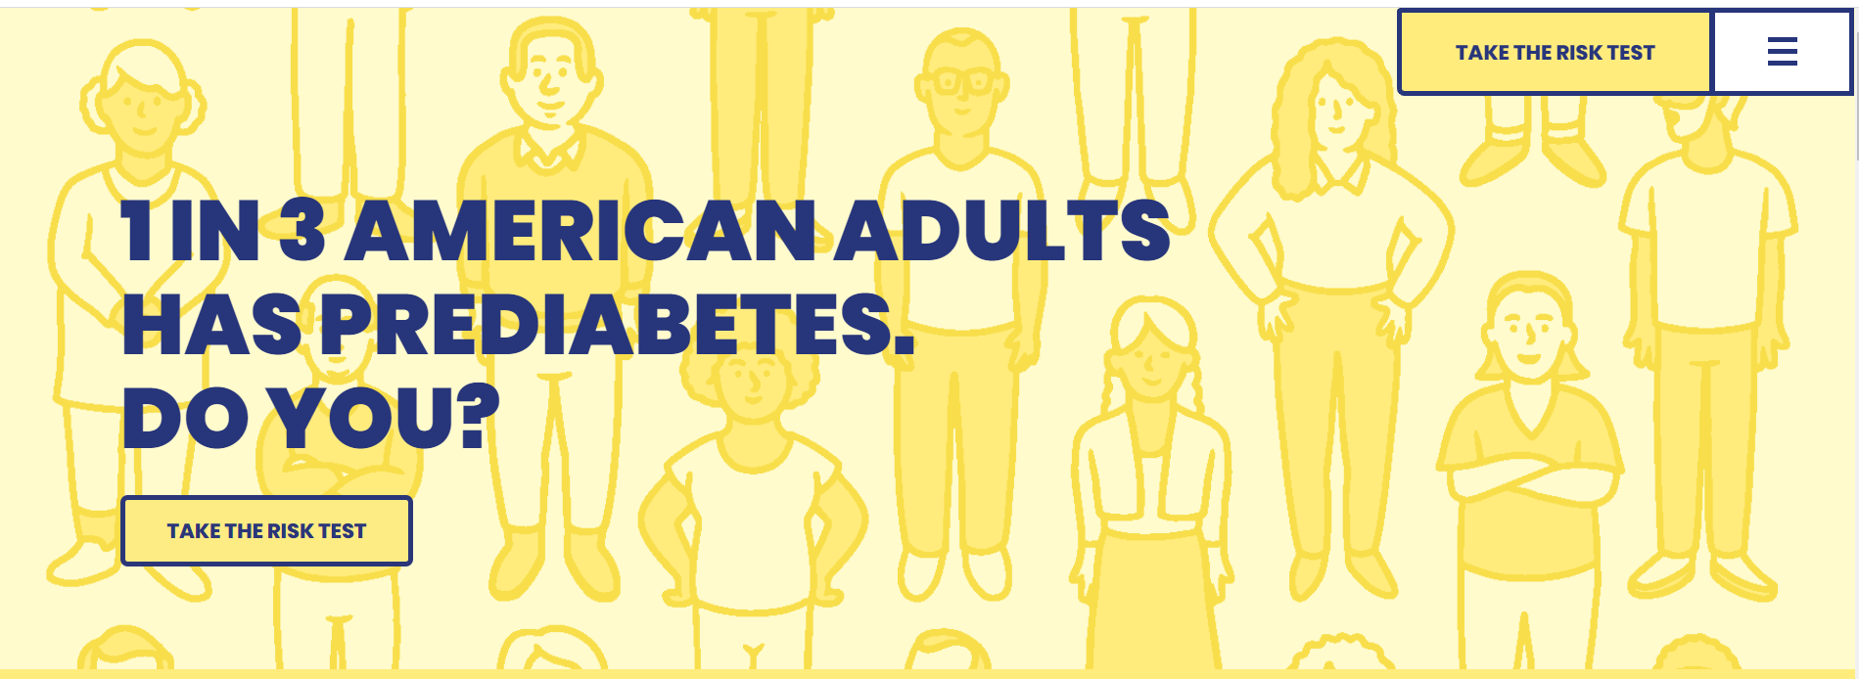
Prediabetes Risk Test
https://www.DoIHavePrediabetes.org
Notes:
Speaker Notes: Participants can take a simple risk test to find out if they might be in the prediabetes range. The risk test can be taken online at DoIHavePrediabetes.org, or printed out on paper. The Ad Council also has campaign materials available for print or web. Our team can help you find those, if needed.

Slide 28
Programs Available in State
Organization | Class Type | Who can participate?
 | In-Person | Public
 | In-Person | Public
 | In-Person | Public
67 CDC-recognized organizations in the US (12 full recognition, 6 preliminary recognition) | Online, Distance Learning, or Combination | Varies by recognized organization
  https://nccd.cdc.gov/DDT_DPRP/Registry.aspx
Notes:
Customization Note: Use the link at the bottom of the slide to update this table for specific markets, or programs available state-wide. Keep in mind, adding a map can also be very helpful.
Speaker Notes: There are [x number] of existing CDC-recognized programs in [state]. CDC has an online registry of all recognized programs in the state. The registry doesn’t show class locations, necessarily, though. A program can have class sites in multiple locations. And sometimes class locations can even change on a weekly basis, depending on several variables. If you prefer virtual offerings, you have [x number] to consider.

Slide 29
Coverage of the National DPP Lifestyle Change Program
Notes:
Speaker notes: It can be helpful to understand who is covering the program in public and private sectors. We know employers tend to follow government purchasing patterns, so let’s start there.

Slide 30
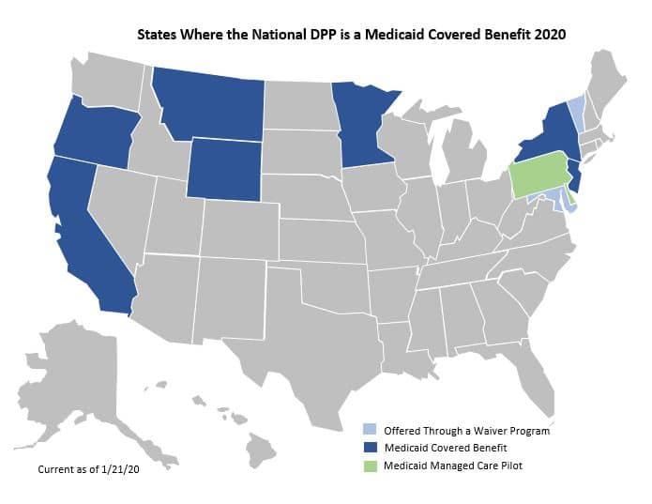
Coverage for Medicaid Beneficiaries
9 states have approved Medicaid coverage for the National DPP lifestyle change program:
California
Maryland
Minnesota
Montana
New Jersey
New York
Oregon
Vermont
Wyoming
Demonstration projects ongoing in Pennsylvania and Delaware
https://coveragetoolkit.org/participating-payers/
Notes:
Speaker Notes: 9 states have approved Medicaid coverage, with additional demonstration work occurring in Pennsylvania.

Slide 31
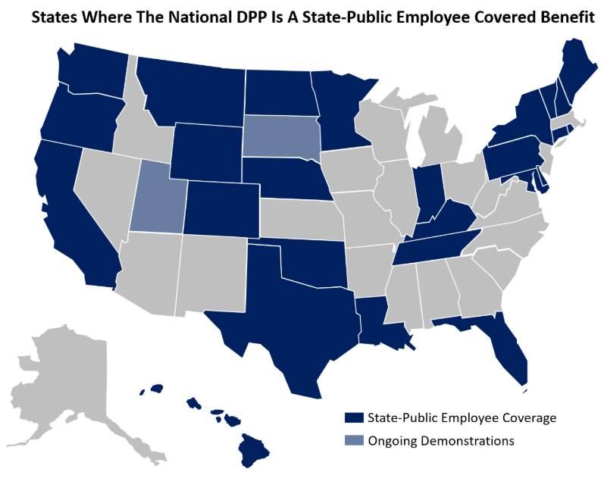
Coverage for Public Employees
Millions of public employees and dependents in 26 states have the National DPP lifestyle change program as a covered benefit
California Colorado Connecticut (DoT) Delaware Georgia (Kaiser members) Hawaii Indiana Kentucky Louisiana Maine Maryland (partial payment) Montana Minnesota | Nebraska New Hampshire New York North Dakota Oklahoma Oregon (educators/local government) Pennsylvania Rhode Island Tennessee Texas Vermont Washington Wyoming
Demonstrations ongoing in South Dakota and Utah
Current as of July 2020
https://coveragetoolkit.org/participating-payers/
Notes:
Speaker Notes: As of July 2020, employers across the U.S. provided the National DPP lifestyle change program as a covered benefit for over 4.9 million lives.

Slide 32
Commercial Insurance Plan Coverage
Many commercial health plans provide some coverage for the National DPP lifestyle change program. Examples include:
AmeriHealth Caritas
Anthem
BCBS: Florida, Louisiana
BS: California
Cigna
Denver Health Managed Care
Emblem Health: New York
GEHA
Highmark
Humana
Kaiser: Colorado, Georgia
LA Care
MVP Medicare Advantage
Priority Health: Michigan
United Health Group
https://coveragetoolkit.org/participating-payers/
Notes:
Speaker Notes: Over 100 commercial health plans and employers offer some level of coverage for their eligible plan members or employees. This list is a sampling of health plans. Keep in mind coverage may be limited to specific books of business, clients, or geographic areas.

Slide 33
You Will Be In Good Company
Costco
Wells Fargo
General Dynamics
University of Utah Health Plan
Dow Chemical
University of Michigan
Bath Iron Works
Kroger
Notes:
Speaker Notes:
Lifestyle change programs are making an impact across the country today. A number of the nation’s most respected companies―including Fortune 100 companies, such as Costco―have successfully adopted this program.
For more examples, visit the Participating Payers page on the Coverage Toolkit.
We know companies are looking to reduce costs while improving employee health. The National DPP lifestyle change program helps you do both while ensuring the health of your employees.
Sources: https://coveragetoolkit.org/participating-payers/;
https://nationaldppcsc.cdc.gov/s/article/Promotional-Materials-for-Employers-and-Insurers

Slide 34


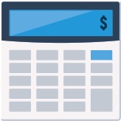

Next Steps on the Path to Coverage
Learn more about how the program could be a good fit by assessing your organization and getting buy in.
Talk to your insurer about including CDC-approved lifestyle change programs like
ours as a covered health benefit
and offer it to
your employees.
Estimate Return on Investment
with CDC’s cost calculator at https://nccd.cdc.gov/Toolkit/DiabetesImpact, or AMA’s cost calculator at https://ama-roi-calculator.appspot.com/.
Consider offering the program at your worksite
with help from one of our trained lifestyle coaches.
Notes:
Speaker Notes: So how can you help your employees address prediabetes and prevent or delay type 2 diabetes?
Learn more about how the National DPP lifestyle change program could be a good fit for your organization by assessing your organization. Present your findings to key decision makers in your organization to get buy in.
If the program isn’t yet covered by your health insurance provider, talk to them. They place great value in your preferences. You can request the lifestyle change program be covered as a health benefit for your next open enrollment period.
If your insurer is unfamiliar with program, third-party administrators can help determine potential Return On Investment (ROI) specific to your organization, as well as implement the program, process claims, recruit participants, and collect data. Or we can help you estimate ROI using a cost calculator.
CDC cost calculator: https://nccd.cdc.gov/Toolkit/DiabetesImpact
AMA cost calculator: https://ama-roi-calculator.appspot.com/
We also have materials available to help you talk with decision makers at your company, as well as with your insurer.
Consider offering the program at your worksite or promote the program being offered online or at another location.
Sources: CDC PPT template for employers: https://nationaldppcsc.cdc.gov/s/article/Promotional-Materials-for-Employers-and-Insurers

Slide 35
Talking with Insurers
Insurers can:
  Partner with you to develop value-based plans for your population
  Contract directly with CDC-recognized organizations to provide the program to their members, including your population
  Manage administrative functions and support identification and recruitment of participants
Notes:
Speaker Notes: A key step you will want to take is understanding if your TPA or health plan currently offers the National DPP. If this is already available, it may be very straight forward to “turn on” that benefit. If not, you can work with the insurer to add this benefit.
The United States Preventive Services Task Force (USPSTF) is an independent panel of experts that publishes recommendations for evidence-based clinical preventive services. The Affordable Care Act requires a subset of health plans to cover items and services with a grade A or B USPSTF recommendation without cost-sharing for the relevant member. The counseling requirements for abnormal blood glucose, healthful diet and physical activity, gestational diabetes, and obesity can be met through coverage of the National DPP lifestyle change program.

Slide 36



Keep Following the Path to Coverage
Designing the benefit involves making key decisions about:
Coverage type
Delivery
Payment model
Program provider
Roll out approach
Work with the National Diabetes Prevention Program to promote the program by including information in emails and your newsletter, on your website, and by placing fact sheets and posters in common areas.
Deliver the program and administer the benefit.
Notes:
Speaker Notes: After you have assessed your organization, talked with your insurers, and gotten buy in from other decision makers in your organization, the next steps on the path to coverage include designing the benefit, identifying and recruiting eligible employees, and administering the benefit.
When designing the benefit, you will make key decisions about:
Coverage type (wellness or medical)
Delivery method (in person, virtual, or a combination)
Payment model
Program provider, including vendor selection and contracting
Phased or full approach to roll out
Next, you will want to develop your plan for identifying and recruiting employees for the program. The National Diabetes Prevention Program provides resources that you can use to promote the program to employees, such as a poster for the workplace; an email, newsletter, or website template; and fact sheet describing the program and its benefits.
Sources: CDC PPT template for employers: https://nationaldppcsc.cdc.gov/s/article/Promotional-Materials-for-Employers-and-Insurers
Although you may be working with an external partner to deliver the program, you’ll have a role even during implementation. You’ll want to make sure your contracted goals are being met, employees are participating, and you are sharing program success with your leadership.

Slide 37
Tools for Employers and Insurers

Slide 38
Coverage Toolkit
Real Solutions from Policy to Payment
https://coveragetoolkit.org/
Notes:
Speaker Notes: National Association of Chronic Disease Directors (NACDD) and the Division of Diabetes Translation at Centers for Disease Control and Prevention (CDC) created the National Diabetes Prevention Program Coverage Toolkit in 2017 as part of the Medicaid Coverage for the National Diabetes Prevention Program (National DPP) Demonstration Project. The demonstration project was established in 2015 and ended in January 2019. NACDD contracted with Leavitt Partners, LLC to take lead on developing this site with input from multiple health plans, national partners, state Medicaid agencies, state public health departments, CDC, and NACDD. The toolkit provides information and resources for employers and commercial health plans interested in covering the program.

Slide 39
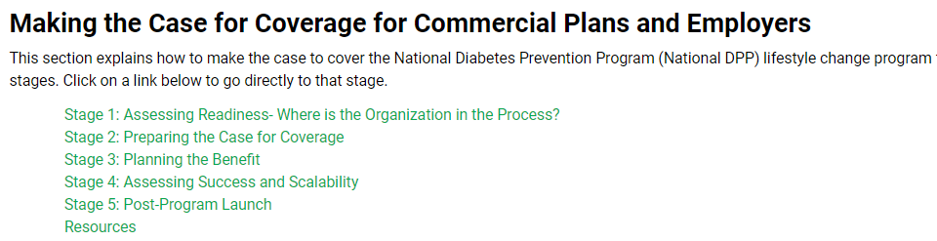
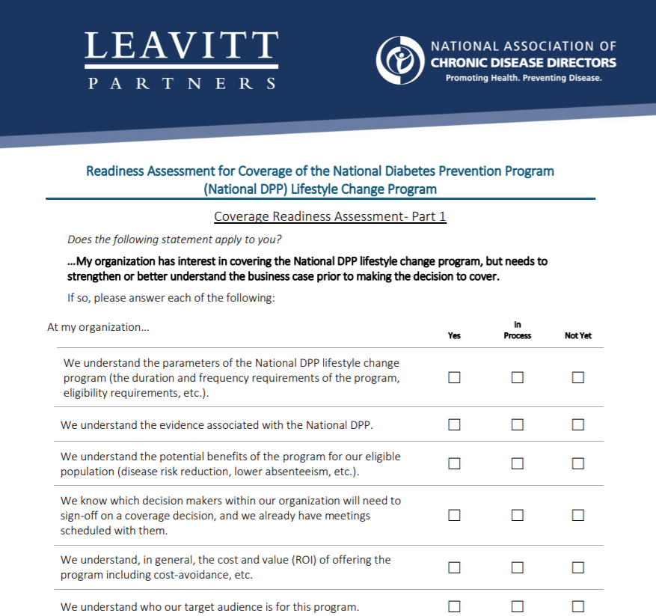
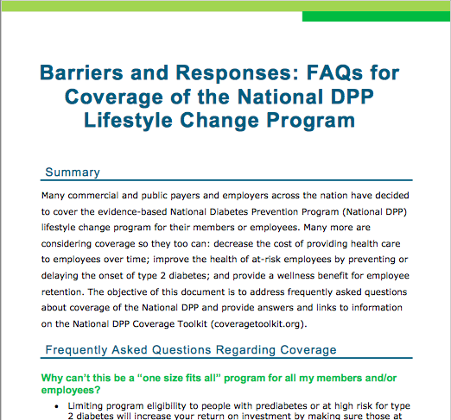
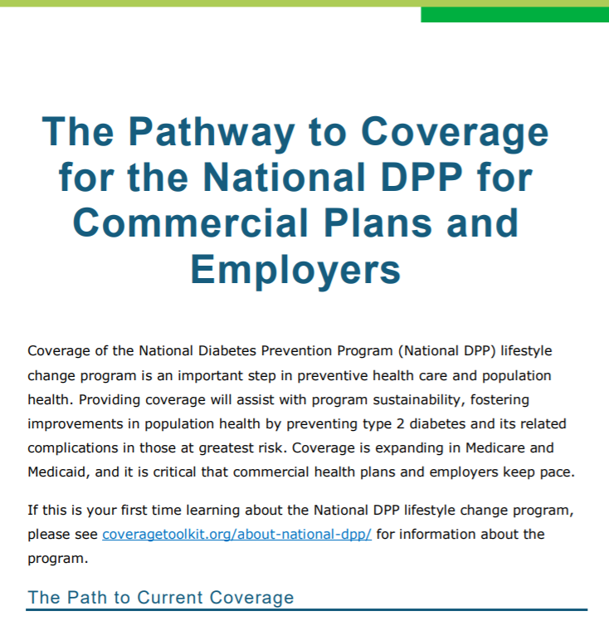
Commercial Payers Section
Readiness Assessment
Barriers & FAQs for Employers
Pathway to Coverage
Notes:
Speaker Notes: A newer addition to the Toolkit is “Case for Coverage for Commercial Plans” page. This page speaks directly to self-funded employers and insurers. It offers tools and resources to help make the case for coverage. https://coveragetoolkit.org/case_commercial/

Slide 40
Customer Service Center
https://nationaldppcsc.cdc.gov/s/
Notes:
Speaker Notes: The purpose of CDC’s National DPP Customer Service Center is to provide organizations easy access to information and resources about prediabetes and the National DPP. Organizations can access training materials, toolkits, and videos; ask questions; and receive technical assistance related to all aspects of the program.

Slide 41
Diabetes Prevention Calculators
Impact Toolkit
Cost Savings Calculator
https://nccd.cdc.gov/Toolkit/DiabetesImpact/Employer
https://ama-roi-calculator.appspot.com/
Notes:
Speaker Notes: Diabetes prevention calculators can be effective tools for helping employers decide whether covering the National DPP lifestyle change program is a good fit for their organizations and employees. CDC’s Diabetes Prevention Impact Toolkit can project the health and economic effects of the National DPP lifestyle change program a given population at risk for diabetes.
The American Medical Association’s Cost Calculator can help users calculate potential medical costs savings from providing the National Diabetes Prevention Program (National DPP) as a covered benefit.

Slide 42
Guidance Documents
Barriers and Responses: FAQ’s for Coverage of the National DPP Lifestyle Change Program
The Pathway to Coverage for the National DPP for Commercial Plans and Employers
https://coveragetoolkit.org/case_commercial/
Notes:
Speaker Notes: These two guidance documents are available on the “case for coverage” page of the Coverage Toolkit. The Pathways document outlines a series of steps to follow as you go through the implementation process. The Barriers and Responses document came out of a request from other stakeholders for talking points around some of the most common challenges we face when working to advance commercial coverage. These are both great resources for employers who are considering adding the National DPP lifestyle change program as a covered benefit for employees.

